Slide 1


NACM’s New Equifax Program and Solutions
Aug 13, 2020

Slide 2
Agenda
Introductions
Program Details
  ePort training
  Product training/innovation
  Thought leadership
  Data growth/vitality
  NACM Sponsorship
Next Steps

Slide 3
Introductions
Chipman Macdonald – NACM Commercial Reseller Channel Manager
Janet Hakami - Sales Support Consultant
Ed Barton - Commercial Exchange Leader
Cathy Spieth – Commercial Risk Specialist

Slide 4
The New NACM - Equifax Commercial Reseller program

Slide 5

New Year, New Relationship
Move from Sales Agent to Reseller
Wholesale pricing
More control of customer experience and access
Increased flexibility and responsibility

Slide 6
Summarizing Program Differences
 | Sales Agent | Reseller | Difference | Business Impact
Pricing | Retail | Wholesale | Customize pricing to fit customer | Faster response; close more business
Billing | By EFX | By NACM | Customer pays NACM sooner, rather than royalty from EFX later | Speed to revenue
Customer Enablement | By EFX | By NACM | Enable customer product access via ePort | Customer satisfaction; speed to revenue

Slide 7
Milestones
Assigned dedicated reseller program support (Janet Hakami)
Signed agreement with NACM Affiliate in Q2 2020
Launch Beta program:
  Training on ePort
  Product training
Seeking 2nd Beta program
Begin rolling out program in Q3 2020 after Beta
PayNet and Ansonia Recent Aquistions

Slide 8
Program Details

Slide 9
ePort
■ Convenient, “one-stop-shop” access to premium commercial solutions
■ No minimum volume requirements
■ Help grow your business with fully scalable services and seamless support for your evolving needs
■ 24/7 online access to the tools you need—whenever and wherever you need them
■ Quickly approve and service customers with real-time access to a robust selection of products
■ Improve your customer support metrics with efficient, single-source access to vital information

Slide 10



Summary – Active Businesses
32.9
million
business identities
96
million
tradelines
5.9
million
linked locations

Slide 11
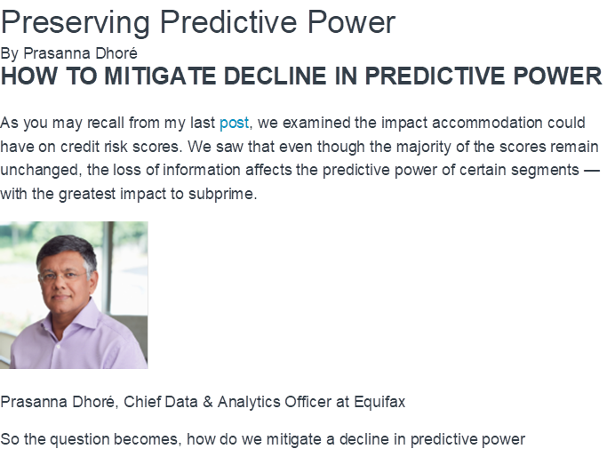
Thought Leadership
Register: Upcoming Market Pulse Webinars
To help our customers navigate through the current economic situation, Equifax is hosting a free Market Pulse webinar series. Industry experts from inside and outside the company will offer timely insights around the economy and credit.
Register for the Series

Slide 12
Top Equifax Solutions
Business Principal Report
Business Credit Industry Report Plus 2.0
Account Monitoring
BusinessConnect
Superior Equifax Non- FI + CFN + SBFE + PayNet + Ansonia data are combined to create the most comprehensive Commercial Risk Data in North America

Slide 13


Online EXPO Showcase
Supporting NACM through Credit Congress sponsorship
Please visit our virtual booth at Credit Congress’ Online EXPO Showcase
Product information and Prizes!
Booth is open

Slide 14
Next Steps
Pursue 3rd^{nd} Beta agreement
Begin wider program roll-out in Q3 and Q4 for new business
Continue periodic updates on product development/thought leadership
Begin discussions on how we can broaden partnership
Sales contest

Slide 15
Copyright © 2019 Equifax Inc. All Rights Reserved. Equifax is a registered trademark of Equifax Inc.

