Slide 1
Coronavirus Portfolio Solutions
8/11/20
Presented by:
Joyce Simas
Account Executive

Slide 2

Strategy Overview
Market Assessment
Tools & Resources:
          Analytical
          Portfolio Management
          Thought Leadership
Taking Action

Slide 3

Market Problems

Slide 4

Coronavirus
Commercial Impact
Coronavirus impact is rapid and widespread, with many unknowns.
Businesses are focusing on immediate and proactive assessment of portfolio risk.
Quick identification of customer segments most impacted is critical.
Proactively monitoring emerging risks to your portfolio is a best-practice portfolio management strategy under any condition.
8/11/2020
Experian Private and Confidential: Coronavirus Portfolio Solutions

Slide 5



Coronavirus
Client feedback and general updates
FI Client
Consumer confidence/spend
Unemployment
Looking for early indicator warnings
Trade Client
Workforce availability
Cashflow
Global volatility/supply shortage
Investor confidence
Insurance
Business continuity coverage
Insurance Claims
Renewal reduction
Lower renewal rates
Unemployment
As of March 2020 unemployment jumped to 4.4%*
*Source: https://data.bls.gov/timeseries/LNS14000000
Expected to be 15% by end of quarter*
*Source: https://tradingeconomics.com/united-states/unemployment-rate
8/11/2020
Experian Private and Confidential: Coronavirus Portfolio Solutions
Notes:
Ann and Ali

Slide 6
Receivable management issues will grow… exponentially
The challenge…
  Significant increase in accounts going delinquent, by multiples, in weeks
  Resource constraints that do not approach the new level of past due accounts
$
Key questions
What projected increase in delinquent accounts are you facing? 2x? 3x? More?
What is the cash flow the business is going to require, as cash is now most important?
Do you have the resources, people, and tools, to meet significant spikes in delinquent accounts?
Given the answers to the above what changes in policies and resources are needed? (and fast)
Cash generation is high priority

Slide 7
Approach to maximize cash flow
Identify the priority challenges facing your business
Assess the resources available for receivable management
Project the needed recoveries in these unprecedented times
Plan for alternate solutions for troubled accounts
1
Engage
Analyze Experian scores by view:
Intelliscore Plus V2 – Segment accounts by delinquency risk categories
Financial Stability Risk – Identify businesses with highest default risk
Recovery Score – For severely delinquent accounts, assess those with a chance of collection
2
Evaluate
3
Act with an efficient plan and generate the results you need-
Focus resources on identified segments that will generate payments and cash flow
For each treatment plan next focus is on secondary targets
Save resources and enact alternate solutions for low priority accounts
Execute

Slide 8
Many trade creditors and lenders are focusing on their existing portfolio’s and supply chains first
1
Trade creditors and FI’s who are trying to manage their own portfolio risk don’t know which accounts are at greatest risk of impact based on the COVID-19 pandemic.
Need helping managing exposures effectively
Assess the resources available for risk segmentation and receivable management
Problem
2
Client portfolio data including: firmographic & geographic classifications like NAICS/SIC, # emps, sales, years in business PLUS payment information like aging and credit utilization
Free Dashboard for comparison against portfolio data
Intelliscore Scores, Financial Stability Risk Scores, & Recovery Scores– all valuable for benchmarking and deeper segmentation
Resources Needed
Identify portfolio exposure segmented by:
  Top 10 industries with highest portfolio exposure/credit utilization
    View by State
    View by County
  Who were my highest risk customers previously, where were they located, and how does their risk increase using the COVID Risk Index simulations.
Focus resources on identified segments generating payments and cash flow
3
How to analyze
8/11/2020
Experian Private and Confidential: Coronavirus Solutions
Notes:
Ann

Slide 9

Analytical Tools

Slide 10
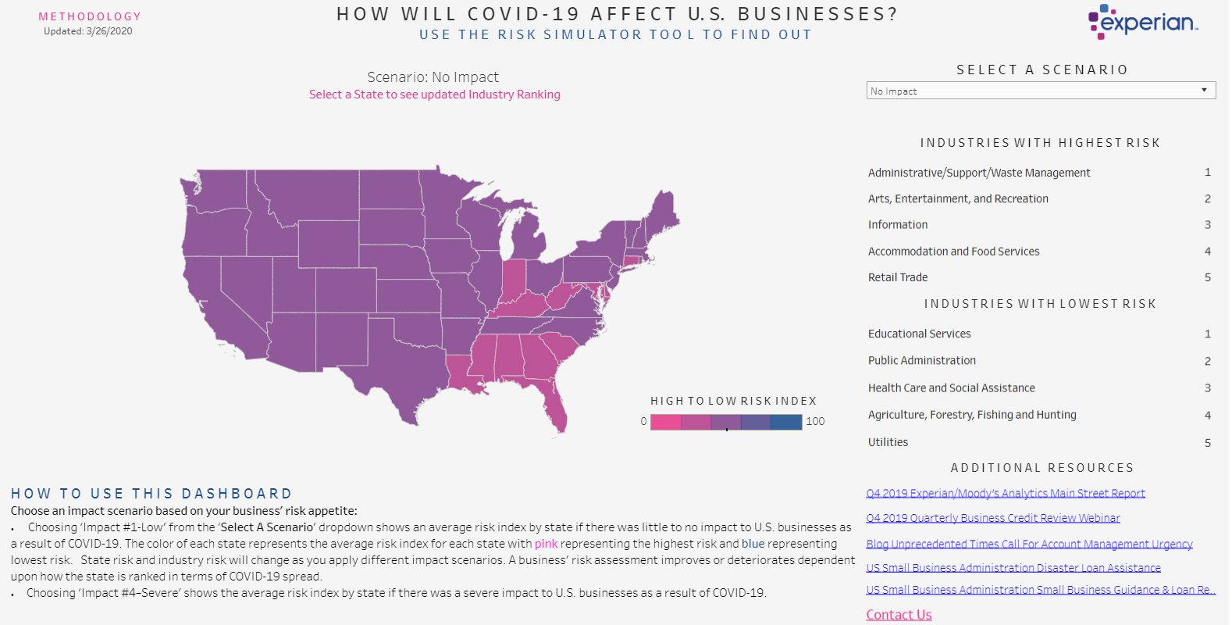
Analytical Tools
Experian BIS’ Free Coronavirus Risk Index
Real-Time data feeds
Regional analysis
Risk analysis

Slide 11

Portfolio Management Tools
Notes:
Ann

Slide 12
Portfolio Scoring
Identify problem accounts early
Portfolio
These appear to be good customers who will continue to pay on time
Customers paying you current
Customers paying you 60 days late
Customers paying you 90 days late
Customers paying you 30 days late
Credit
Scores
Gain insight into potential for delinquency
Low risk of future delinquency
Medium risk of future delinquency
High risk of future delinquency
What looks like a low risk customer has a high potential to become a future loss
8/11/2020
Experian Private and Confidential: Coronavirus Portfolio Solutions

Slide 13

Portfolio Scoring process
File returns actionable information
Your customer data
  Name
  Address, city, state, zip
  Total balance
  Current balance
  Aged past due balanced
Portfolio Scoring
file
Portfolio Scoring file
  Business ID information
  Your DBT
  Overall DBT
  Tradelines
  Your balance
  Total balance
  Score
  Legal balance
  Legal items
  Years on file
  Bankruptcies
  Derogatory items
  Percentile
8/11/2020
Experian Private and Confidential: Coronavirus Portfolio Solutions

Slide 14

Portfolio Scoring
Benefits of scoring:
Faster decisions
Reduce slow pay/losses
Efficiency by segmenting accounts by risk
Focus resources in account management
Handle accounts quickly and efficiently, with less risk
8/11/2020
Experian Private and Confidential: Coronavirus Portfolio Solutions
Notes:
Ann

Slide 15

Using Account Monitoring Service (AMS) can help
What is Experian’s Account Monitoring Service? It is a comprehensive and proactive monitoring system notifying you of key events occurring within your portfolio.
Receive notifications on up to 99 different events including:
Daily notification on Bankruptcies and other emerging events
  Late Payments (30, 60, 90 day delinquency)
  Bankruptcy alerts
  Lien, Judgment, & Collection filings
  Score change alerts
  Total balance changes
  Credit utilization changes
8/11/2020
Experian Private and Confidential: Coronavirus Portfolio Solutions
Notes:
Nicky

Slide 16

Supply Chain Evaluation

Slide 17
Supply Chain Risk Management Solutions
Available in BusinessIQ
New Supplier Registration
Supplier Risk Assessment
Supplier Monitoring
Supplier Analysis / Match & Append
Streamline onboarding of new suppliers
Capture documentation like license, proof of insurance, financial statements and more.
Access risk with new suppliers
Financial Stability Score
Corporate Linkage
Economic Diversity
OFAC
Match & Append data to aid in
Spend Analysis: Risk Scores,
Linkage, Diversity Data
Key Risk Indicators / KPI’s
Customizable KPI metrics
Bankruptcy
Financial Risk
Public Records
UCC Fiilings
Debarred

Slide 18
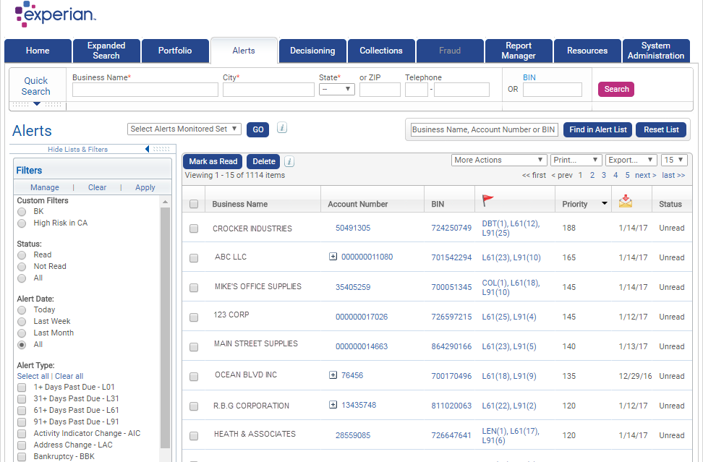
Supplier Alerts
Monitoring critical suppliers helps you reduce costly supply chain disruptions
1
Select an Alerts Monitored Set (portfolio)
Review Alert Detail
After completing review,
user marks alert as “Read”
Export and Printing capabilities exist for easy downloading / saving
1
2
3
2
4
4
3
Notes:
Text slide [uses Title and Content layout]
The headline appears in Arial (Experian Dark Blue) at 36pt. If a subheadline is required, it should be manually sized to 22pt.
The text has five pre-set levels in 17pt Arial, to a maximum width of 23.4cm:
Level 1 – ranged to the left margin for continuous text; if you require a bold subheading you can embolden this to 18pt Arial Bold
Level 2 – ranged to the left text margin with a round bullet, subsequent lines aligning with the text of the previous line
Level 3 – horizontal dash bullet, subsequent lines aligning with the text of the previous line
Level 4 – round bullet, subsequent lines aligning with the text of the previous line
Level 5 –horizontal dash bullet, subsequent lines aligning with the text of the previous line
Advancing through the text levels can be done by using the ‘Increase List Level’ and ‘Decrease List Level’ buttons in the ‘Paragraph’ tools on the ‘Home’ ribbon.
If your text content exceeds the depth of the text box, you may need to consider creating an additional slide.
The brand mark on this slide layout is set up at the correct size and position and should not be altered. The date and footer info can be edited across all slides by using the ‘Header and Footer’ settings on the ‘Insert’ ribbon (do not edit these manually on the individual slides).

Slide 19

Understanding collections prioritization
“According to many findings, an analyst [collections] spends only 20% of his / her time on correspondence and the rest of the time organizing who to call...”
“More than 70% of collection calls are made to customers who would have paid anyway.”
“Prioritized accounts in a worklist is the single most important feature for collections analysts.”
Credit Research Foundation
Credit & Financial Management Review
8/11/2020
Experian Private and Confidential: Coronavirus Portfolio Solutions

Slide 20
Commercial Recovery Score
New commercial collection model for optimizing results
Avoid wasted time and resources on no pay accounts
Model Highlights
Model Development
  Balance outstanding required
  Score Scale — 300-850
  Exclusion scores
    999 not enough information
    997 collection amount missing
    996 collection amount zero
  Bankrupt companies will be scored
  Model development timeframe, sample of collection accounts placed April-2016 to October-2018
  “Good” definition — 25% or $100 collected within 6 months
  700,000 accounts used in process, 500,000 for model build, 200,000 as holdout
  6 model segments related to size of business and size of collection placed
  Logistic regression model development process utilized
8/11/2020
Experian Private and Confidential: Coronavirus Portfolio Solutions

Slide 21
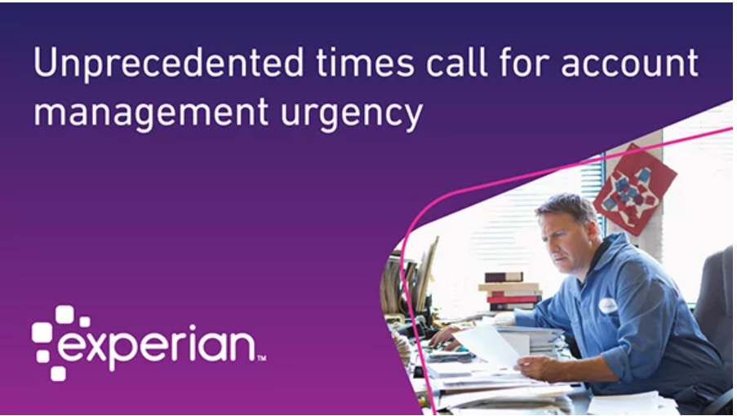


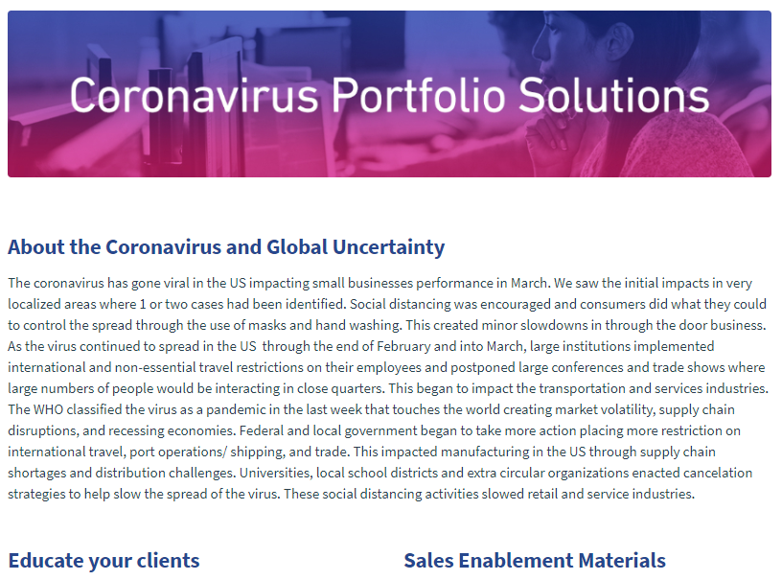


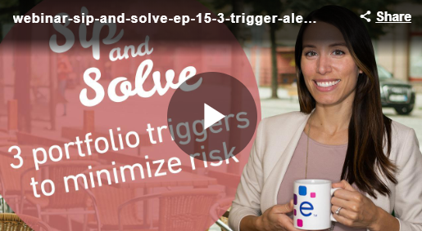




Thought Leadership Resources
Available on Seismic
Blogs
Macroeconomic reports
Sip & Solve
Whitepapers
8/11/2020
Experian Private and Confidential: Coronavirus Portfolio Solutions
8/11/2020
Experian Private and Confidential: Coronavirus Portfolio Solutions
Notes:
Ali

Slide 22

COVID-19 Offerings
Notes:
John

Slide 23
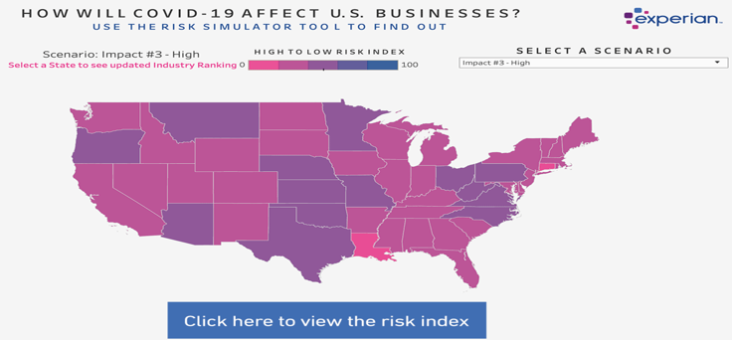
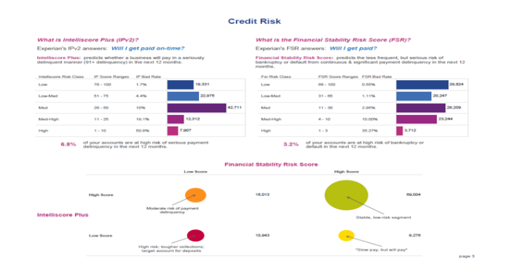
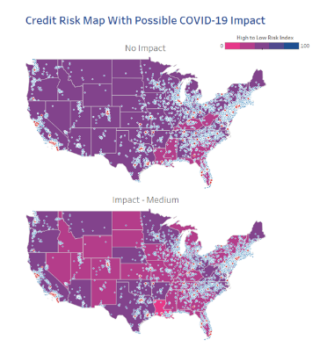
Special Client Offers
Available to new or existing clients
Analysis
  Free COVID-19 Experian Risk Index
Portfolio
  Free 1x Portfolio View with any new Portfolio Scoring program (PVR includes the No Impact and Medium Impact Risk Scenarios
Alerts
Special Pricing Offer available through 9/30/20
8/11/2020
Experian Private and Confidential: Coronavirus Portfolio Solutions
Notes:
John

Slide 24
Questions?
Notes:
Steve

