Slide 1
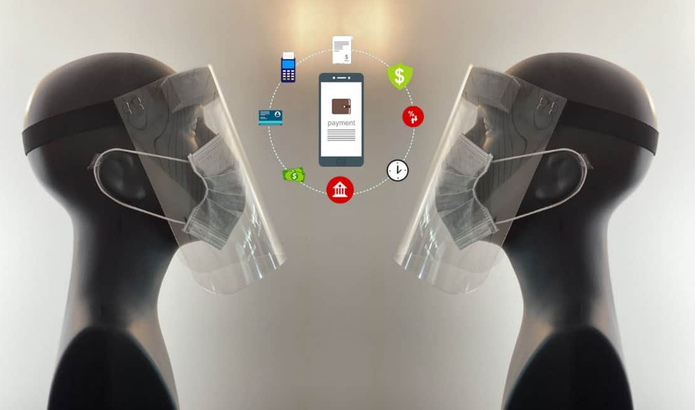


Efficiency Requirements
The new normal of accepting payments – contactless payments

Slide 2

TODAY’S PRESENTERS
MICHAEL WILLIAMS
DEAN MIDDLETON
VICE PRESIDENT * Presenter
Phone: 800-858-5256 x 7019
Direct: 786-264-7019
mwilliams@unitedtranzactions.com
UTA PRESIDENT * Co-Presenter
Phone: 800-858-5256 x 7001
Direct: 786-264-7001
dmiddleton@unitedtranzactions.com
Disclaimer: This communication, including any content herein and/or attachments hereto, is provided as a convenience only, does not constitute legal advice, does not create an attorney client relationship, and does not alter your current merchant services agreement. Because of the generality of this communication, the information provided herein may not be applicable in all situations and does not constitute a comprehensive list of issues that could impact your business. All merchants, including UTA - worldpay clients, are subject to the terms of their bank card merchant agreement, the card networks’ operating regulations, and applicable federal and state laws.

Slide 3













CUSTOMERS INCLUDE

Slide 4

Adapting to Today's Business Environment
The past few months have rewritten payment rules for merchants of all industries.
Contactless and electronic payments are a must-have.
Has your business determined how to facilitate payments amidst COVID-19?
Have you asked yourself: What are the available payment solutions that can provide for your business needs?

Slide 5

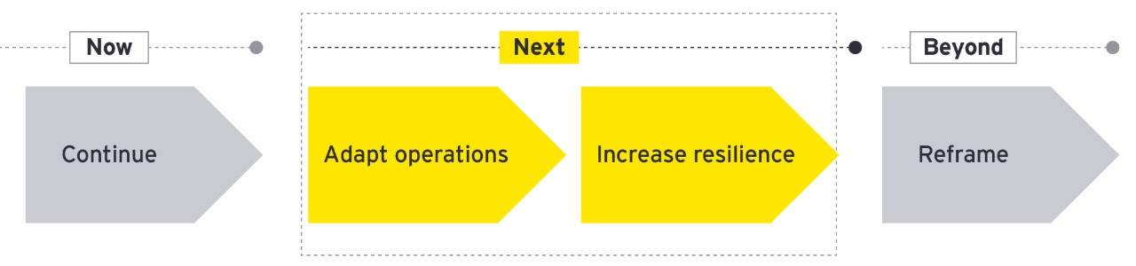
Adapting to Today's Businesss Environment
Changes in the global economy, technology adoption, societal norms and consumer behavior will together shape this future. Companies will need to ask: What can we do now to make us ready for what lies beyond?
Changes in the global economy, technology adoption, societal norms and consumer behavior will shape the future.
What can we do now to make us ready for what lies beyond?

Slide 6


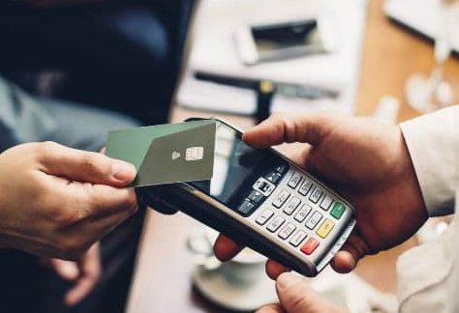
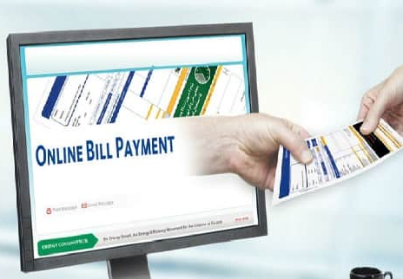



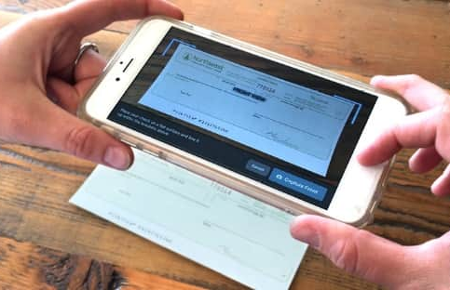



CONTACTLESS PAYMENTS
COVID-19 has caused a drastic shift in the way merchants do business. Businesses are pivoting away from face-to-face exchanges to contactless solutions during this pandemic.
ACH Processing
Credit Card Processing
Credit Card Surcharging
Online Payment Portal
Mobile Deposit

Slide 7
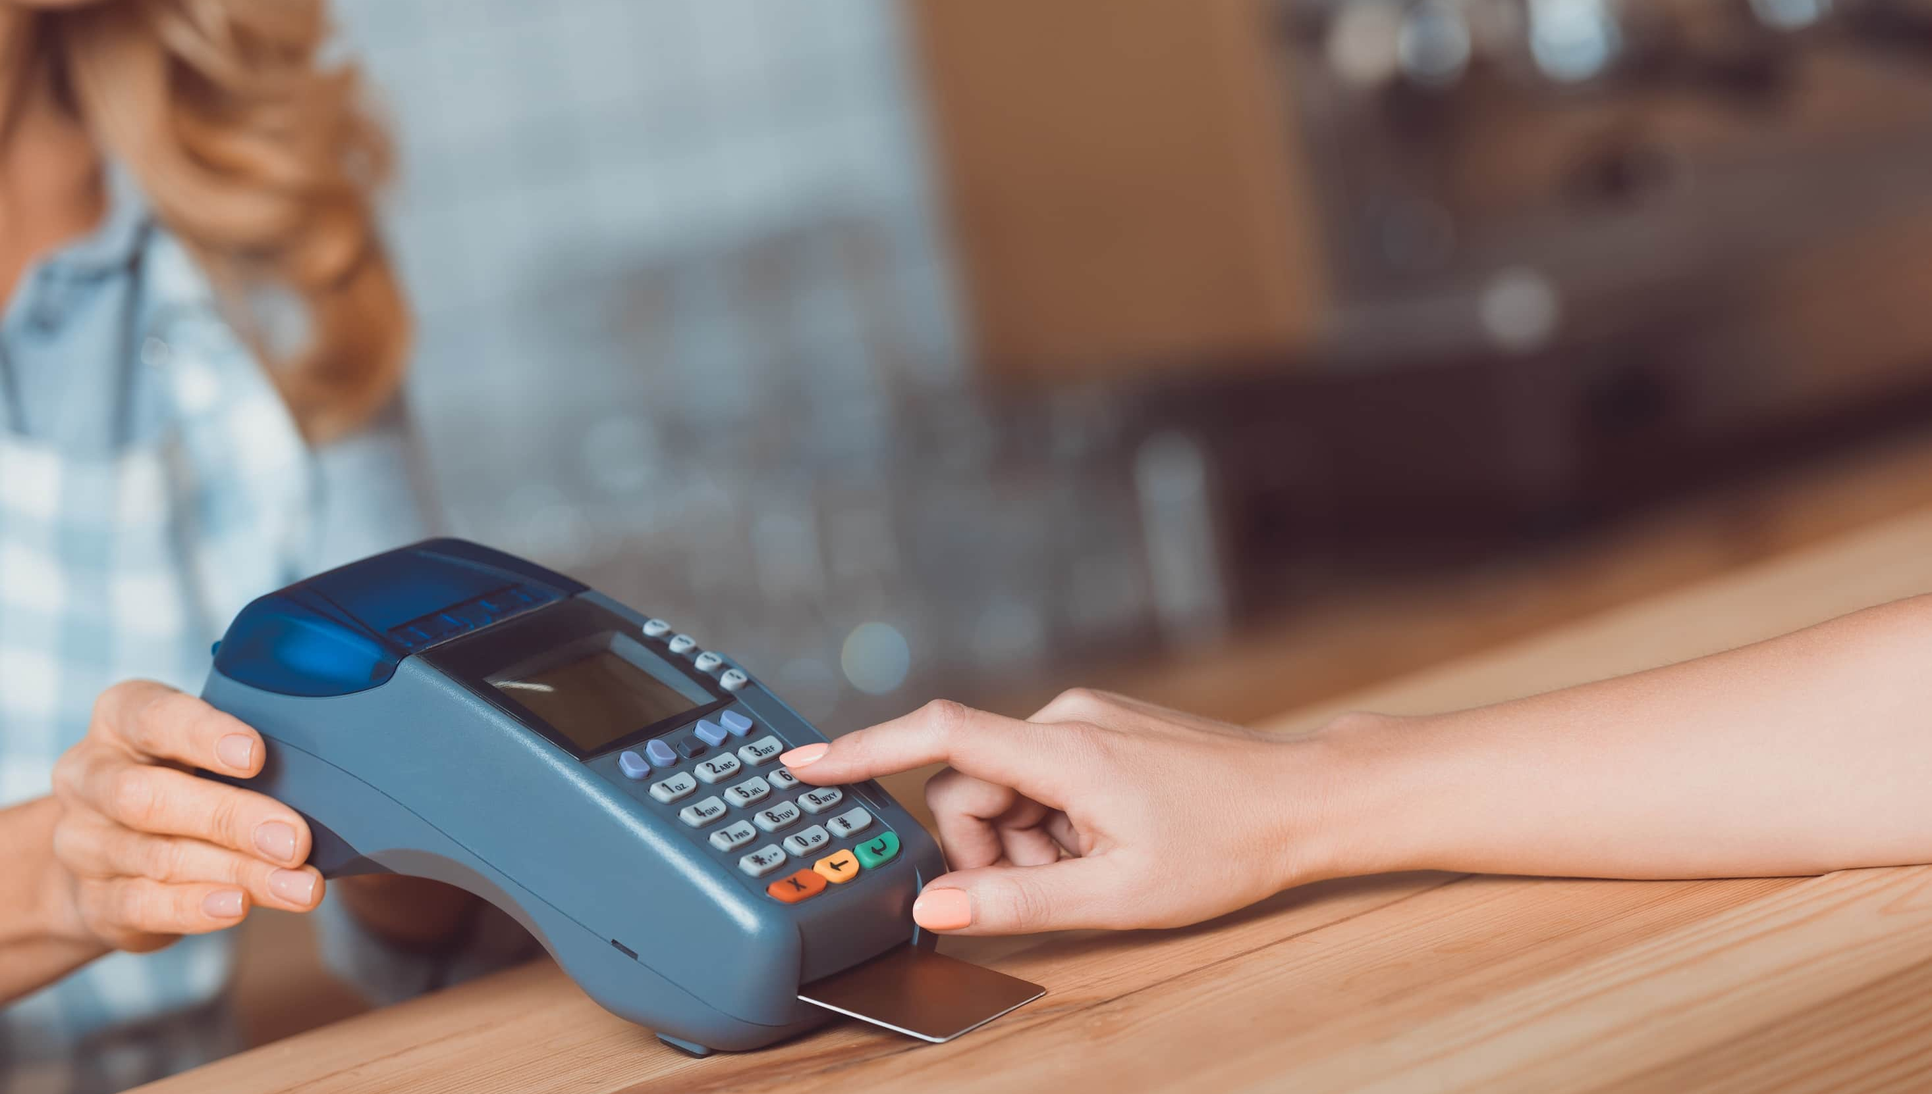






PAYMENT ACCEPTANCE CHANNELS
Remote and electronic payment channels are a must-have for all merchants. They are secure, compliant, and, most importantly, limits physical interaction.
Mail-In
Back Office
Counter Sales
Face to Face
Payments over the Phone
Online Payment Portal
API
Mobile

Slide 8

Fortune Magazine says to expect three major permanent
changes in the wake of COVID-19
More Government Regulation on Businesses
Focus on Fiscal Resilience…
  Protect the safety of all employees
  Protect the bottom line
  Reduce and manage costs
Contact Free Environment to Remain Permanent

Slide 9

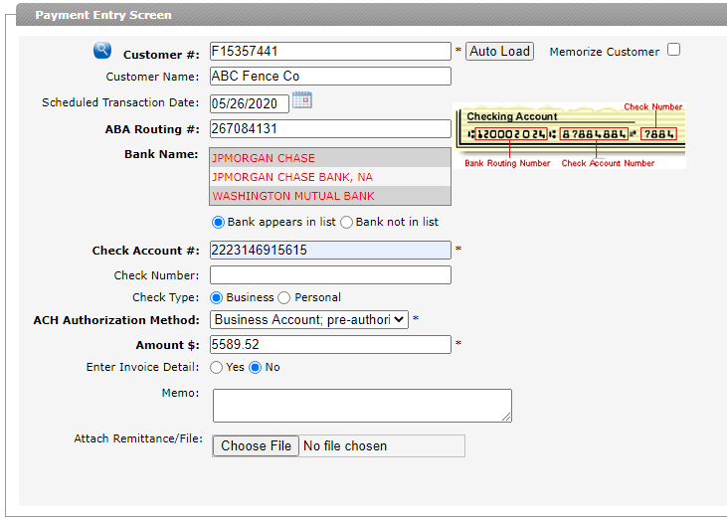

ACH PROCESSING
Features:
Instant - collect your money now
Secure
Accelerated access to Funds
Reduces Costs
Future payments
Recurring transactions
Eliminate Post Office Delays

Slide 10

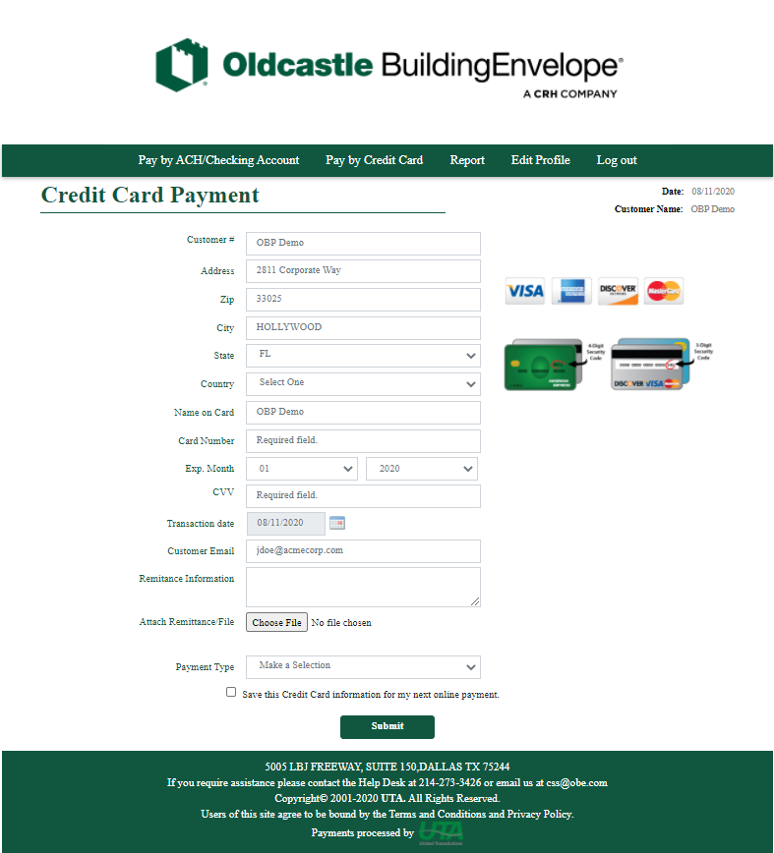
Online Payment Portal
Accept Secure Customer Initiated Payments on your Website.
Works with your current banking relationship
No development work required
Fully hosted – turnkey solution
Virtual Remittance Feature: Simply attach and send!

Slide 11
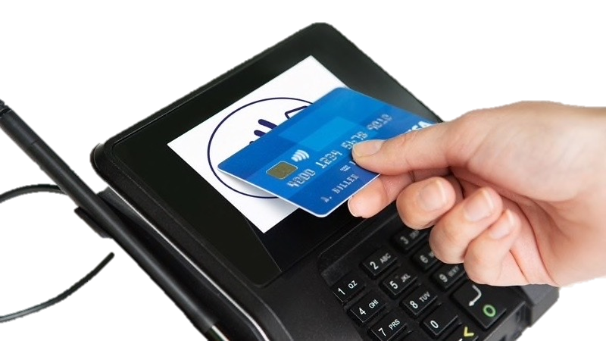

CREDIT CARD
Processing
Features:
Discounted processing fees
Automated Level 2 and 3 Processing
Surcharging
P2PE Validated Solution
PCI Compliant
Tokenization
EMV

Slide 12
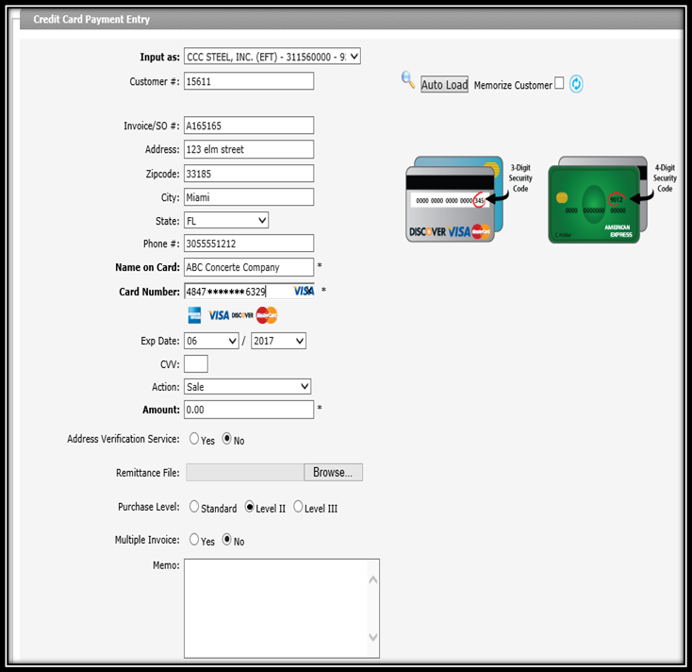
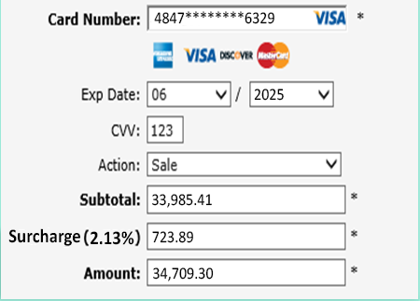
CREDIT CARD
Surcharging
Features:
Reduce compliance exposure
Smart surcharge calculation will apply the fee automatically
Surcharging notification and disclosure requirements will be provided
Card validation occurs at the point of entry. Only qualified payments are surcharged
ATTACH

Slide 13
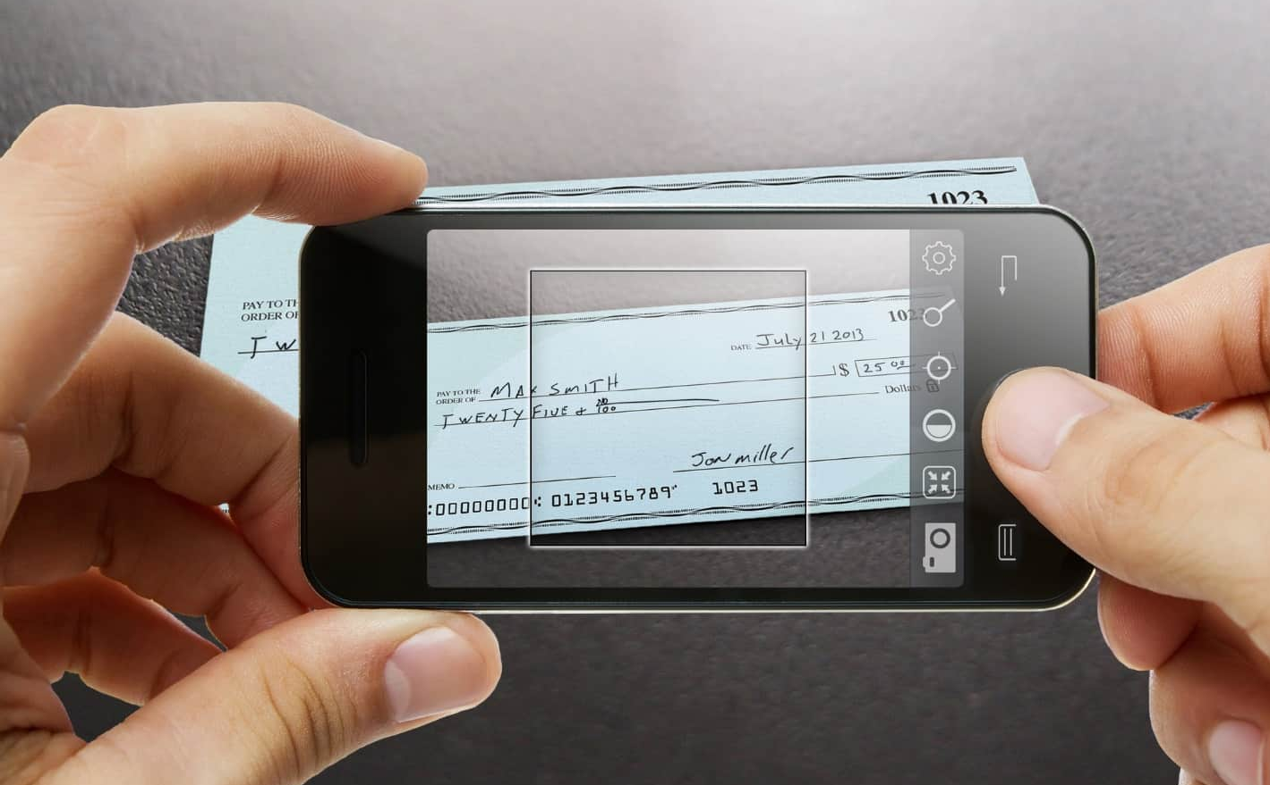
MOBILE DEPOSIT
Process Payments on the Go!
Use the camera on your mobile phone or tablet to deposit checks
Supported on iOS and Android Devices
No additional equipment or peripherals to purchase
Real time access to your transactions via standard UTA reporting tools
Money in the bank!
It’s that simple

Slide 14

CHECK
GUARANTEE
Features:
Highest Average Check Amount Approvals
Highest Approval Rates
No mistake programs
Designated Customer Service Manager

Slide 15

SUMMARY
Financial resilience will​ flow from lowering the​ cost base over the longer​ term, and increasing ​liquidity in the short term​
We are in a new normal, and businesses must adapt to excel.
This not only keeps revenue coming in the virtual door but also allows your customers to safely make payments regardless of the status of your physical business operations.

Slide 16


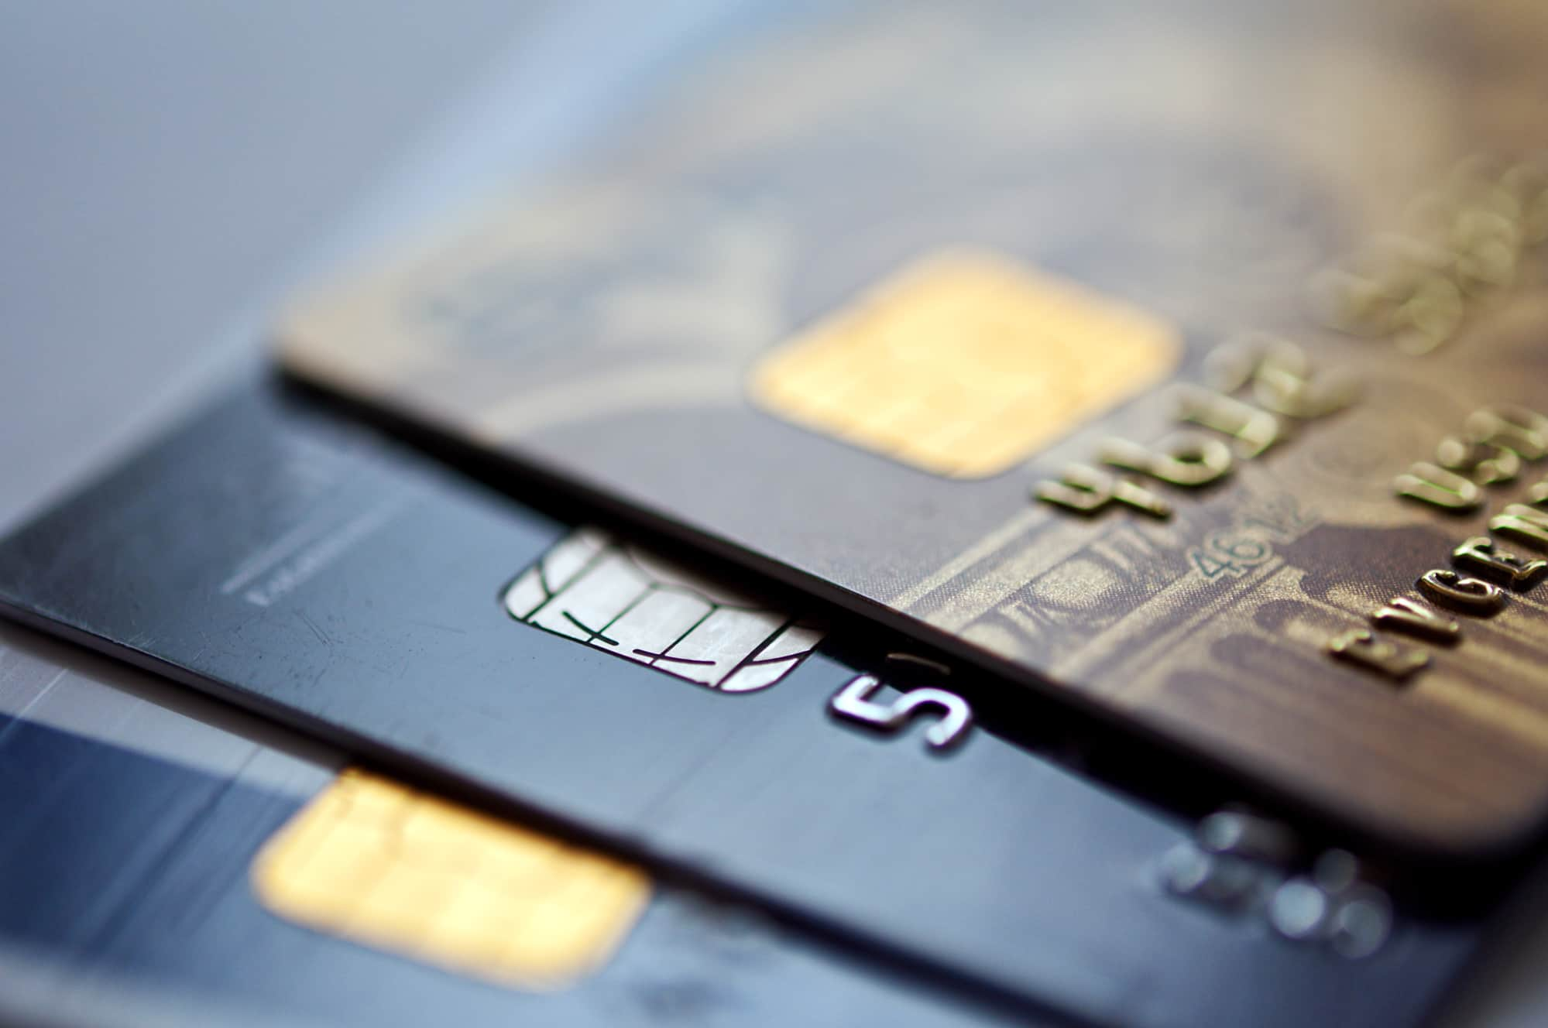


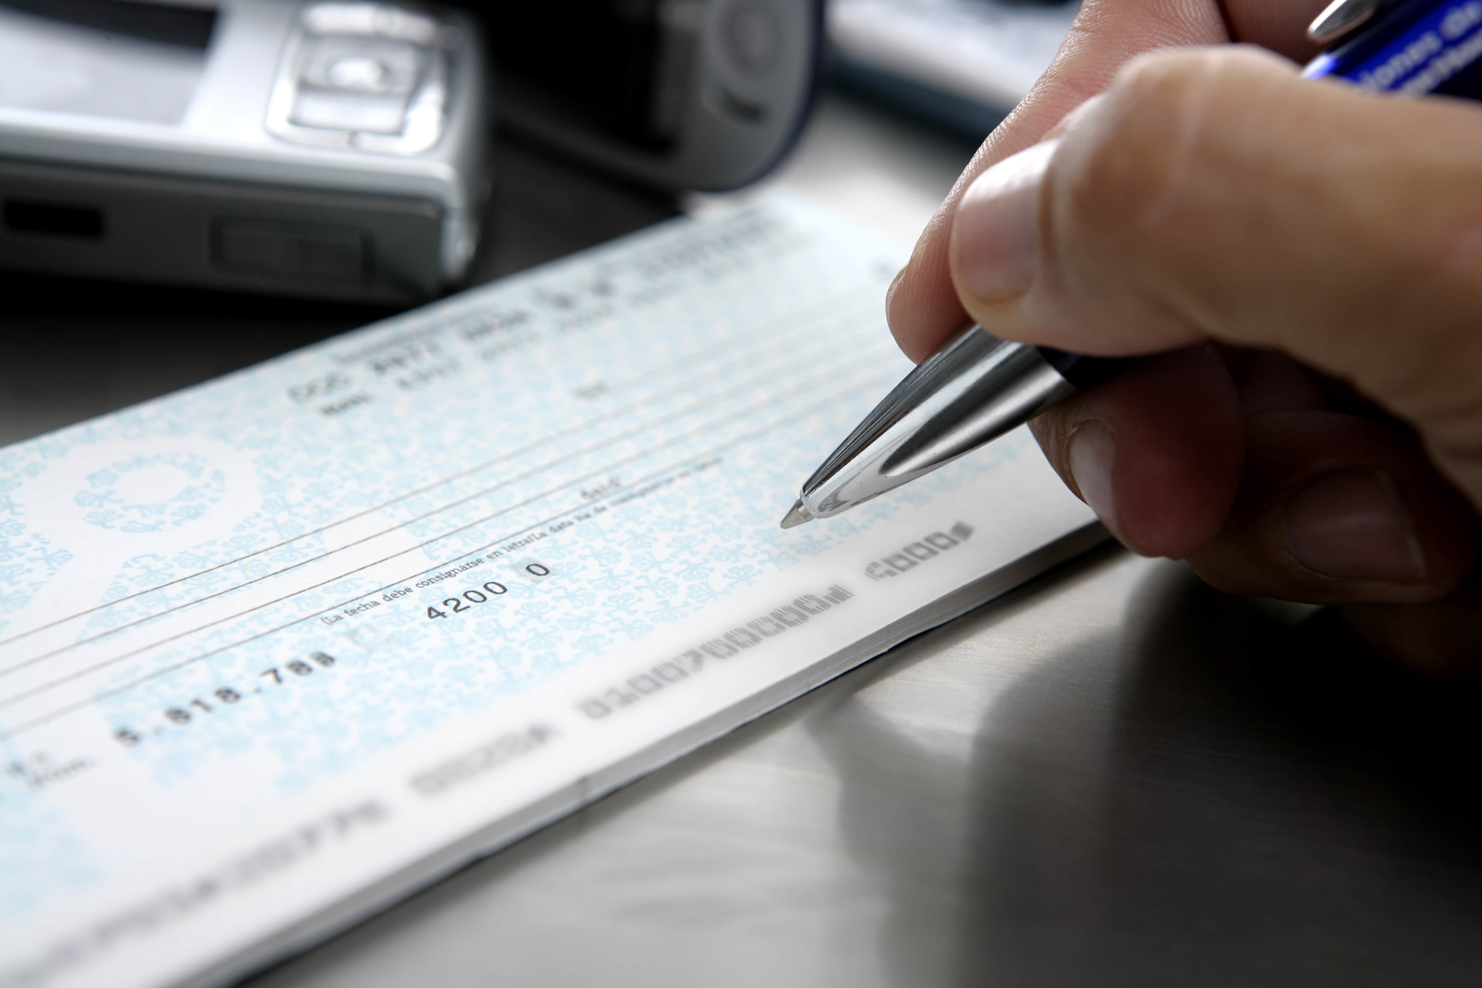

PAYMENT PROCESSING SOLUTIONS
Standard Check Guarantee
Remote Deposit Capture
Credit Card Processing
ACH Processing
Online Payment Portal
Mobile Deposit
Credit Card Surcharging

Slide 17
CUSTOMERS INCLUDE

Slide 18



Slide 19
CONTACT US
MICHAEL WILLIAMS
DEAN MIDDLETON
VICE PRESIDENT * Presenter
Phone: 800-858-5256 x 7019
Direct: 786-264-7019
mwilliams@unitedtranzactions.com
UTA PRESIDENT * Co-Presenter
Phone: 800-858-5256 x 7001
Direct: 786-264-7001
dmiddleton@unitedtranzactions.com
Disclaimer: This communication, including any content herein and/or attachments hereto, is provided as a convenience only, does not constitute legal advice, does not create an attorney client relationship, and does not alter your current merchant services agreement. Because of the generality of this communication, the information provided herein may not be applicable in all situations and does not constitute a comprehensive list of issues that could impact your business. All merchants, including UTA - worldpay clients, are subject to the terms of their bank card merchant agreement, the card networks’ operating regulations, and applicable federal and state laws.

